Slide 1
Team : SyncSpace
Sarala Sharanappa Kanakagiri
Suhas Shetty
sharanappakanakagi.s@northeastern.edu
shetty.suh@northeastern.edu
Ullas Puttaiah
Ayush Patil
puttaiah.u@northeastern.edu
patil.ay@northeastern.edu

Slide 2

Reminisce: Capturing Moments, Connecting Worlds
Welcome! Today, we'll explore Reminisce, a groundbreaking social media platform designed to help users capture and share life's most cherished moments. Built on the MERN stack, it offers a comprehensive suite of features for creating and exploring personalized memory albums.

Slide 3
Overview: A MERN Stack Social Media Platform
Memorable Moments
Interactive Experience
Reminisce empowers users to create and curate albums filled with photos, videos, and written descriptions of life's most significant events.
Users can explore each other's memory albums, interact through comments, and engage in meaningful conversations.

Slide 4
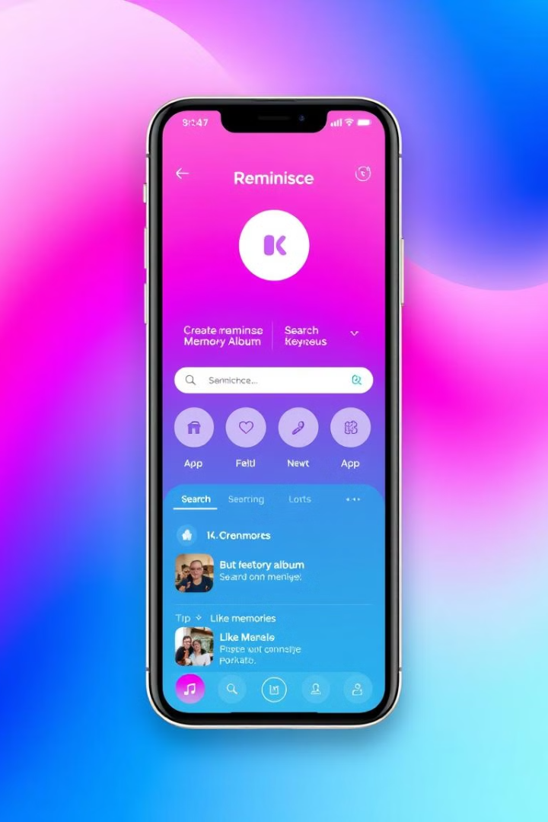
Key Features: A Comprehensive Set of Tools
1
1. User Authentication
2
2. Memory Management
Secure user authentication is provided through JWT and Google OAuth integration.
Users can easily create, read, update, and delete memories within their albums.
3
3. Advanced Search & Filtering
4
4. Rich Text Editor
A user-friendly rich text editor allows for detailed and expressive memory descriptions.
Efficiently find specific memories using robust search and filtering options.

Slide 5
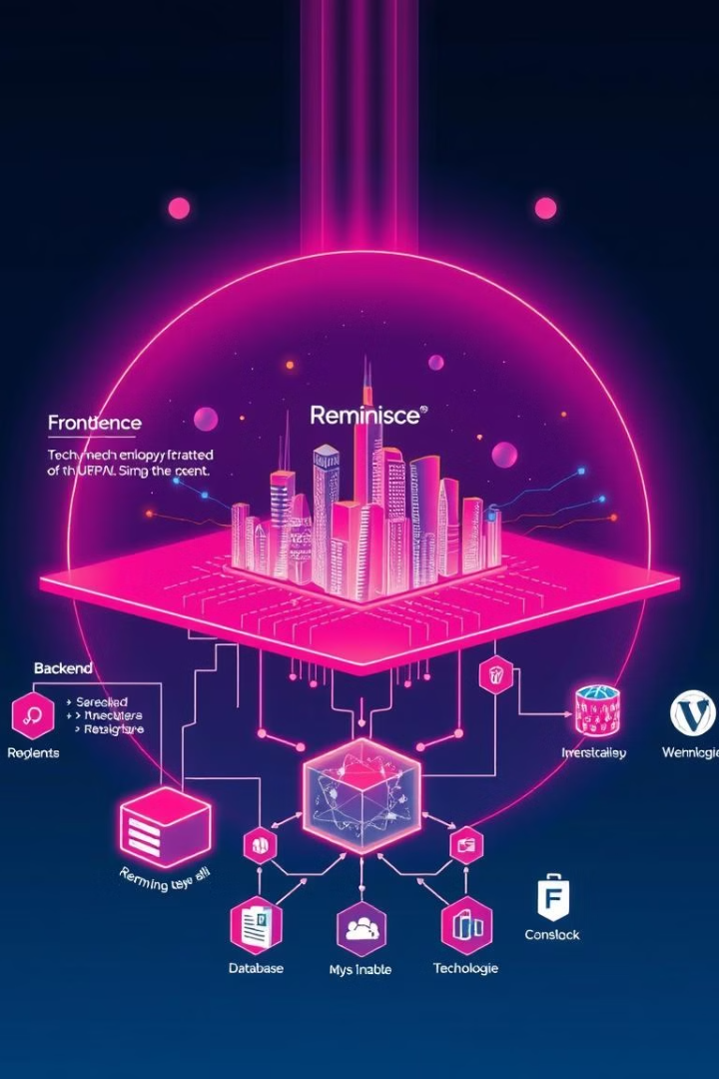






Technology Stack: Powerful and Scalable
React.js
Node.js with Express.js
A robust and flexible JavaScript library for building dynamic user interfaces.
A powerful backend framework for building scalable and efficient web applications.
MongoDB
JWT Auth
A flexible and scalable NoSQL database for storing and managing data efficiently.
Secure authentication methods for user accounts and access control.
Tailwind CSS
Redux
A utility-first CSS framework that can be composed to build any design, directly in your markup.
A JS library for predictable and maintainable global state management

Slide 6
API Endpoints: Seamless Integration and Data Flow
POST /auth/signup
1
Registers a new user with secure authentication.
2
POST /auth/signin
Allows existing users to log in securely.
GET /posts
3
Retrieves all memories with pagination for efficient loading.
4
GET /posts/search
Enables searching for specific memories.
POST /posts
5
Creates a new memory within a user's album.
6
PATCH /posts/:id/likePost
Allows users to like or unlike memories.
POST /posts/:id/commentPost
7
Adds a comment to a specific memory.

Slide 7
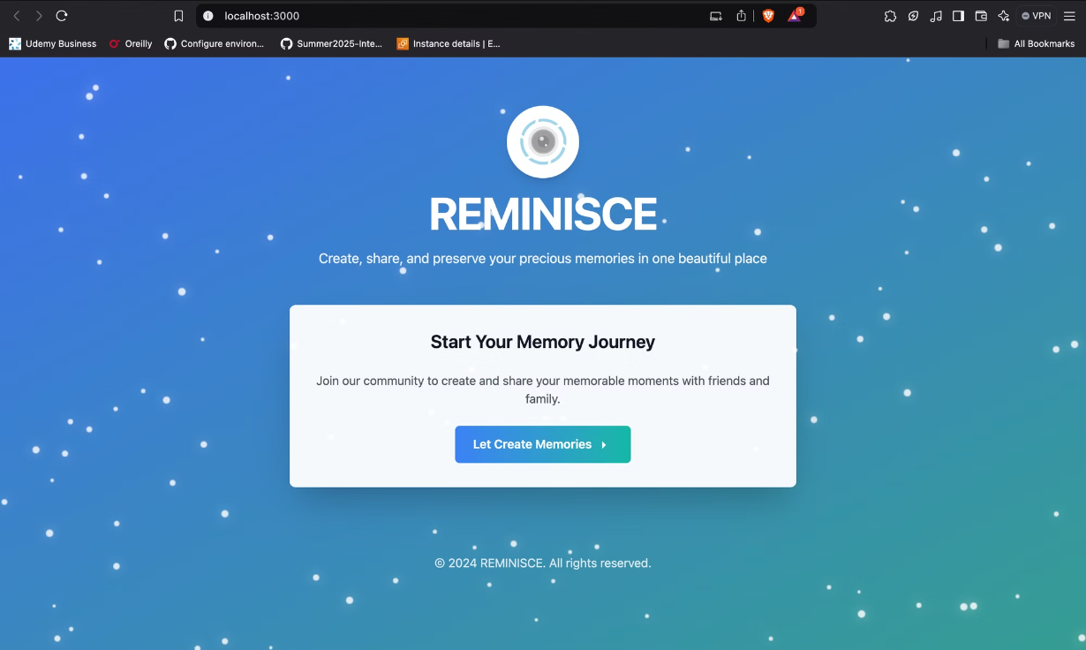
Landing Page

Slide 8
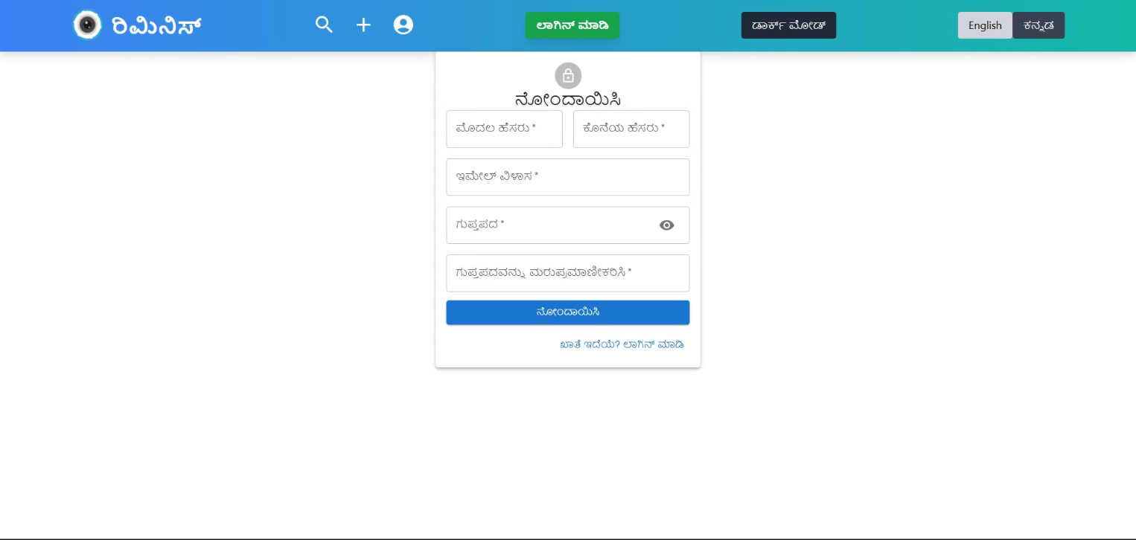
Registration page

Slide 9
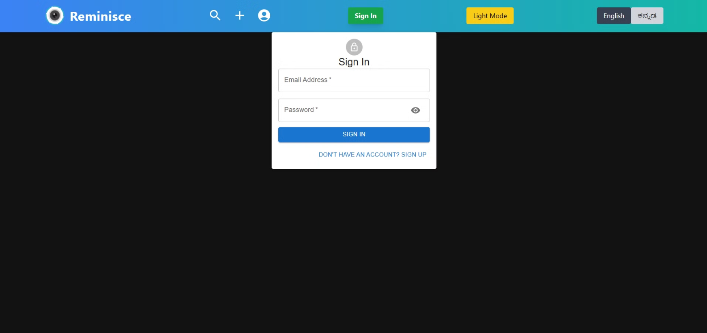
Sign In Page

Slide 10
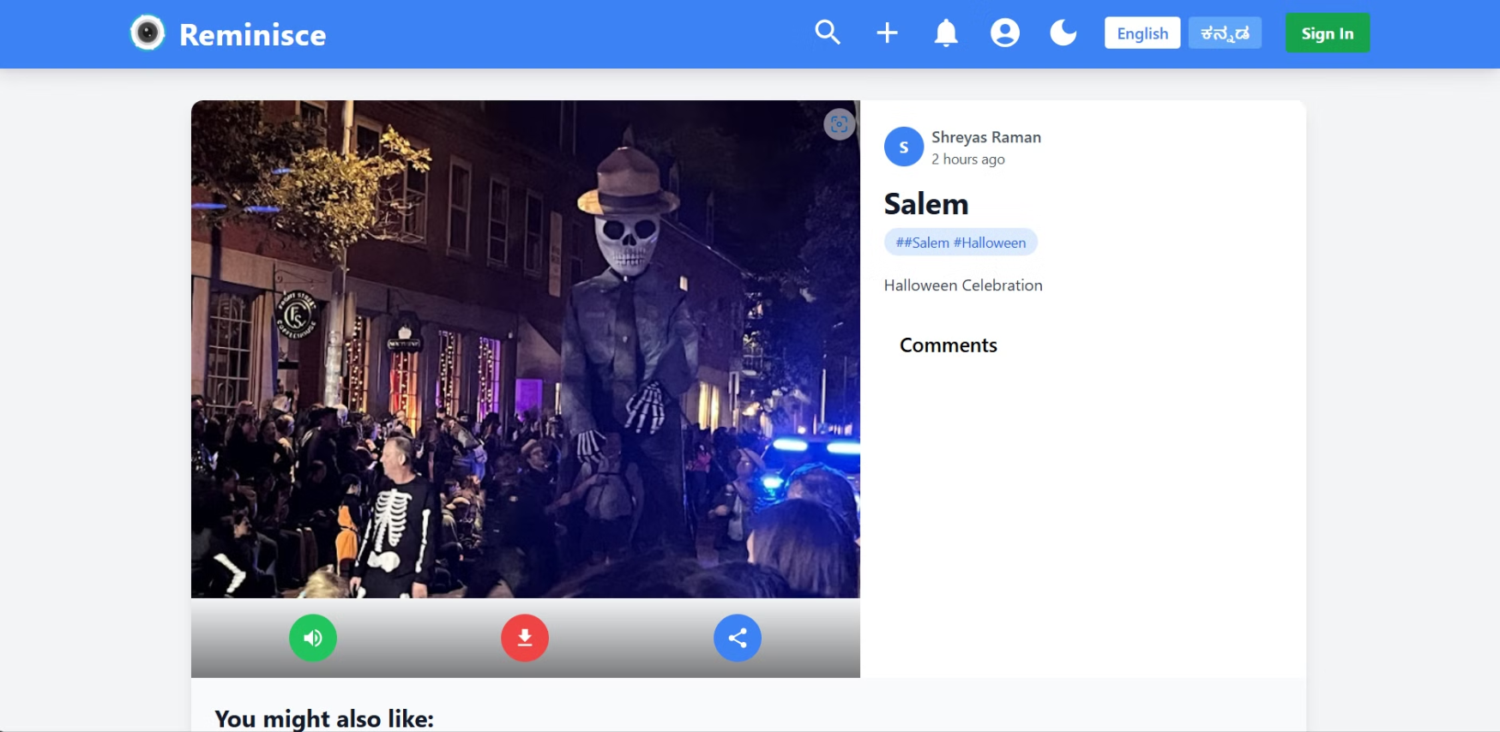
User posts page

Slide 11
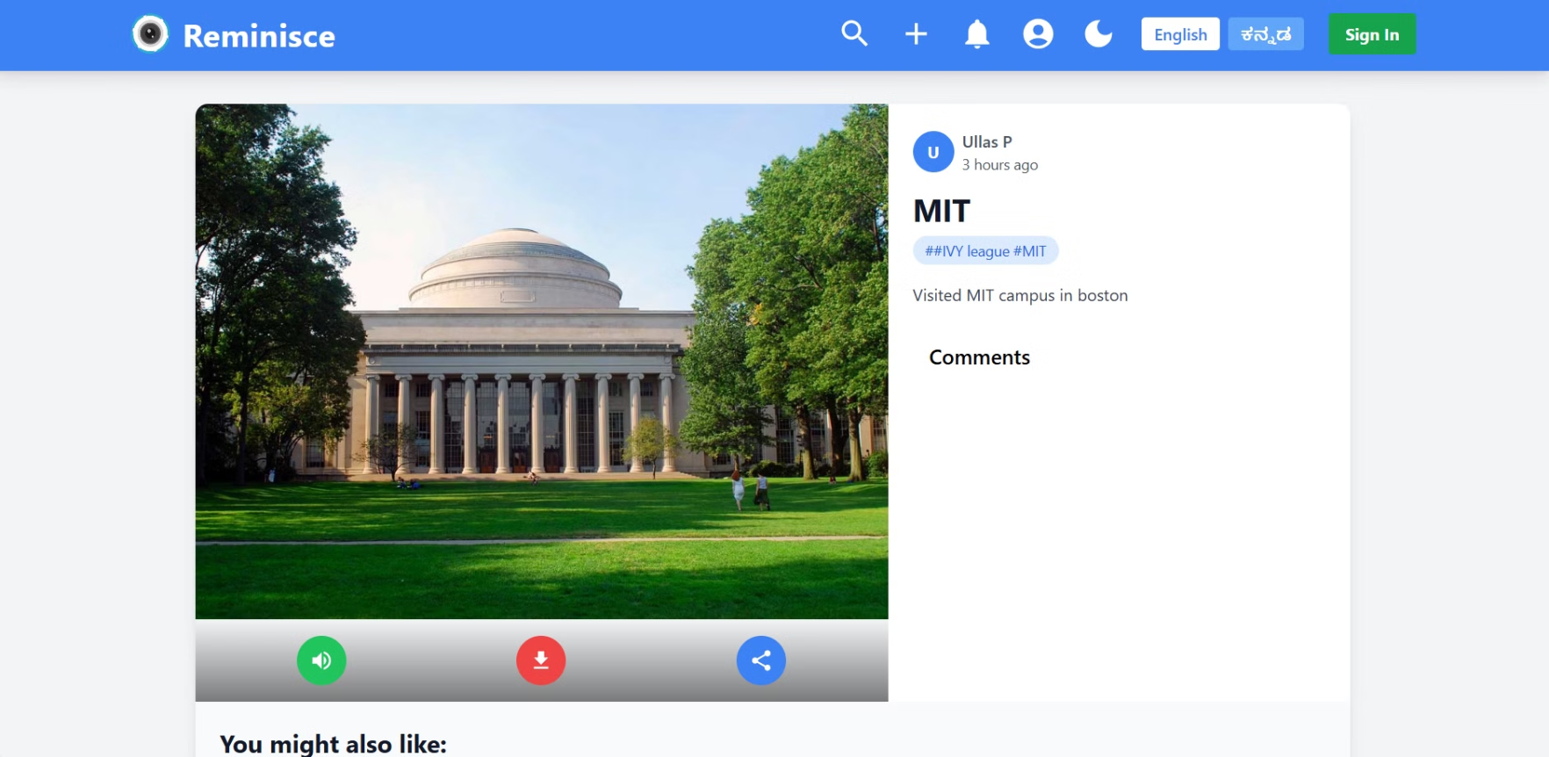
Specific post with comments

Slide 12
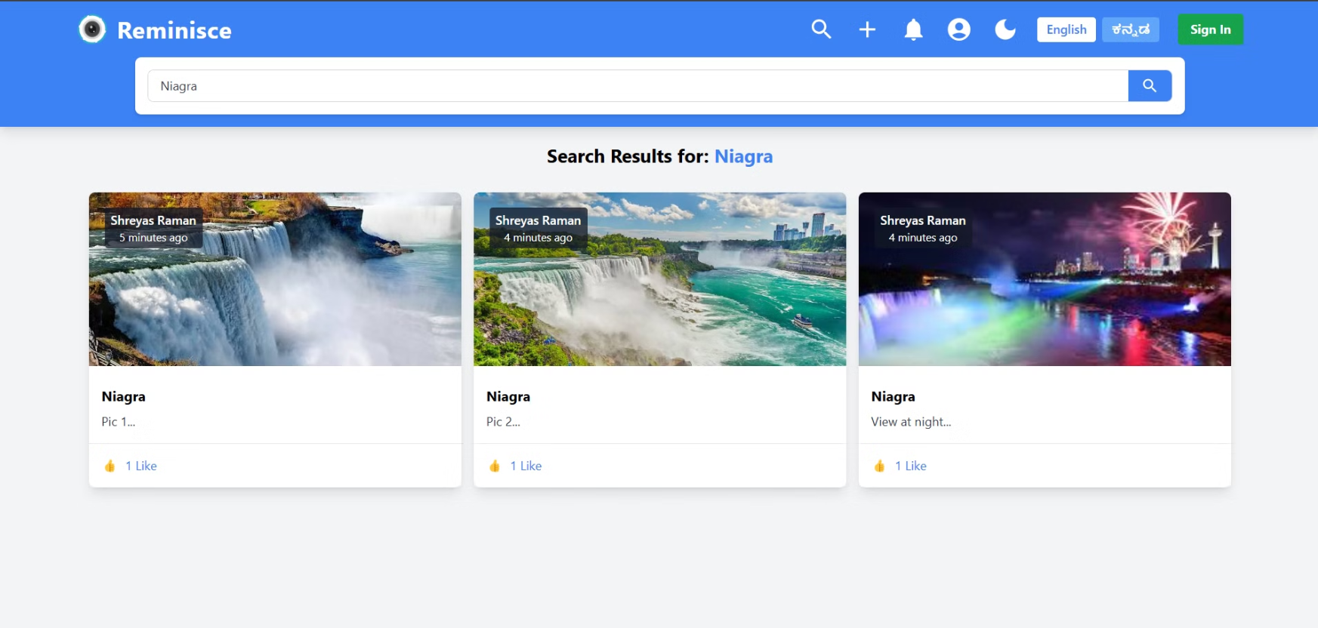
Search Button

Slide 13
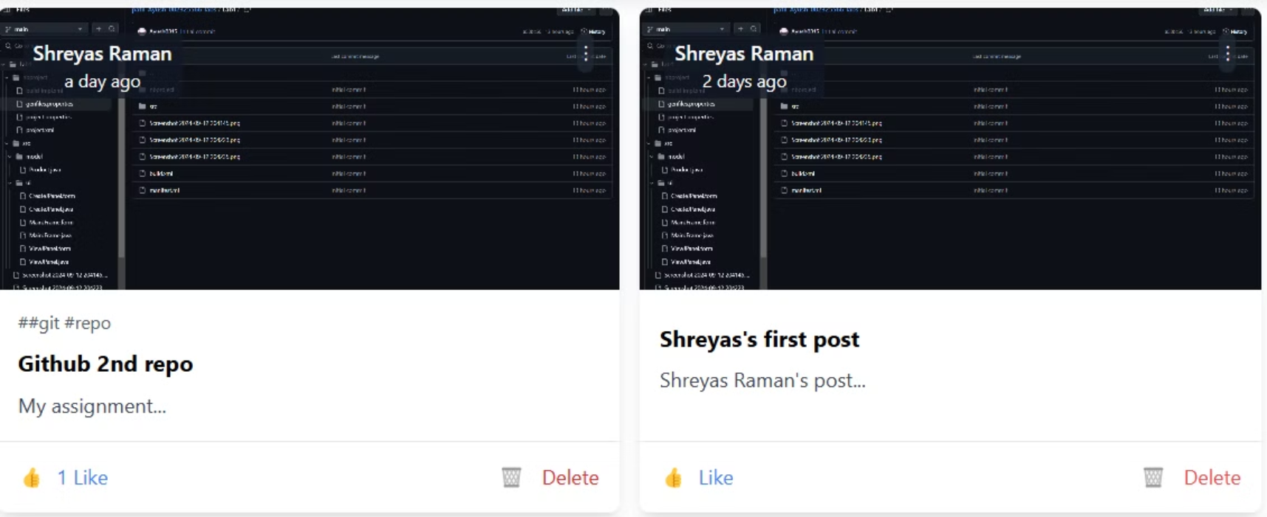
Delete Button

